Slide 1


Noida Institute of Engineering and Technology, Greater Noida
KCS 501
Database Management System
Unit: 1
Introduction & Data Modeling using the Entity Relationship Model
Ram Kumar Sharma
Assistant Prof IT Deptt.
NIET Gr Noida
B.Tech. (IT) 5th Sem

Slide 2

Introduction of Faculty
Name: Mr. Ram Kumar Sharma
Designation: Assistant Professor, IT Department
Qualification: M.Tech(CSE) From UPTU, Luknow in 2014.
Teaching Experience: 11 Years
Industry Experience :- 1 year and 8 Months
Organization: Tech Mahindra Pvt. Ltd. Noida.
5 months work as a IT Trainer cum Software Developer from September 2009 to Feb 2010 on JAVA Platform.
Organization: Cynex Global Pvt Ltd, New -Delhi.
1 year and 3 month Experience as a software Developer from June 2008 to August 2009 on JAVA Platform.
Research Publications:
Particulars | Journals | Conference(IEEE)
International | 12 | 00

Slide 3
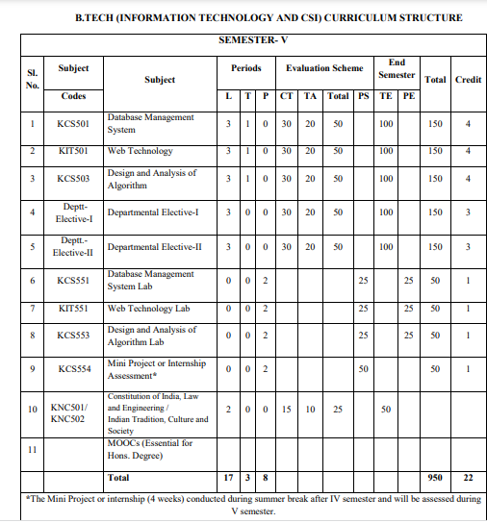
Evaluation Scheme

Slide 4
Syllabus
UNIT 1
Introduction: Overview, Database System vs File System, Database System Concept and Architecture, Data Model Schema and Instances, Data Independence and Database Language and Interfaces, Data Definitions Language, DML, Overall Database Structure. Data Modeling Using the Entity
Relationship Model: ER Model Concepts, Notation for ER Diagram, Mapping Constraints, Keys, Concepts of Super Key, Candidate Key, Primary Key, Generalization, Aggregation, Reduction of an ER Diagrams to Tables, Extended ER Model, Relationship of Higher Degree.

Slide 5
Syllabus
UNIT 2
Relational data Model and Language: Relational Data Model Concepts, Integrity Constraints, Entity Integrity, Referential Integrity, Keys Constraints, Domain Constraints, Relational Algebra, Relational Calculus, Tuple and Domain Calculus. Introduction on SQL: Characteristics of SQL, Advantage of SQL. SQl Data Type and Literals. Types of SQL Commands. SQL Operators and Their Procedure. Tables, Views and Indexes. Queries and Sub Queries. Aggregate Functions. Insert, Update and Delete Operations, Joins, Unions, Intersection, Minus, Cursors, Triggers, Procedures in SQL/PL SQL

Slide 6
Syllabus
UNIT 3
Data Base Design & Normalization: Functional dependencies, normal forms, first, second, 8 third normal forms, BCNF, inclusion dependence, loss less join decompositions, normalization using FD, MVD, and JDs, alternative approaches to database design
UNIT 4
Transaction Processing Concept: Transaction System, Testing of Serializability, Serializability of Schedules, Conflict & View Serializable Schedule, Recoverability, Recovery from Transaction Failures, Log Based Recovery, Checkpoints, Deadlock Handling. Distributed Database: Distributed Data Storage, Concurrency Control, Directory System.

Slide 7
Syllabus
UNIT 5
Concurrency Control Techniques: Concurrency Control, Locking Techniques for Concurrency Control, Time Stamping Protocols for Concurrency Control, Validation Based Protocol, Multiple Granularity, Multi Version Schemes, Recovery with Concurrent Transaction, Case Study of Oracle.
References:
1. Korth, Silbertz, Sudarshan,” Database Concepts”, McGraw Hill
2. Date C J, “An Introduction to Database Systems”, Addision Wesley
3. Elmasri, Navathe, “ Fundamentals of Database Systems”, Addision Wesley
4.Bipin C. Desai, “ An Introduction to Database Systems”, Galgotia Publications

Slide 8
Course Objective
List and explain the fundamental concepts of a relational database system
Knowledge of DBMS, both in terms of use and implementation/design.
Experience with SQL and Manipulate a database using SQL
Increased proficiency with the programming language C++.
Experience working as part of team v Experience with analysis and design of (DB) software
Assess the quality and ease of use of data modeling and diagramming tools
Utilize a wide range of features available in a DBMS package.

Slide 9
Course Outcome
S. NO. | Course Outcomes | Blooms’ Taxonomy
KCS501.1 | Apply knowledge of database for real life applications. | K3
KCS501.2 | Apply query processing techniques to automate the real time problems of databases. | K3, K4
KCS501.3 | Identify and solve the redundancy problem in database tables using normalization | K2, K3
KCS501.4 | Understand the concepts of transactions, their processing so they will familiar with broad range of database management issues including data integrity, security and recovery. | K2, K4
KCS501.5 | Design, develop and implement a small database project using database tools. | K3, K6

Slide 10
Program Outcome’s (PO’s)
Program Outcomes
[PO1] Engineering Knowledge:
Apply the knowledge of mathematics, science, engineering Fundamentals and an engineering specialization to the solution of complex engineering problem
[PO2] Problem Analysis
An ability to analyze a problem, and identify and define the computing requirements appropriate to its solution.
[PO 3] Design Development of solution:
an ability to design, implement, and evaluate a software or a sw/hw system, component, or process to meet desired needs within realistic constraints such as memory, runtime efficiency, as well as appropriate constraints related to economic, environmental, social, political, ethical, health and safety, manufacturability, and sustainability considerations;

Slide 11
Conti…
Program Outcomes
[PO 4] Conduct investigations of complex problems
an ability to design and conduct experiments, as well as to analyze
and interpret data using research based knowledge and research
method;
[PO 5] Modern tool usage
an ability to use the techniques, skills, and modern engineering tools necessary for practice as a engineering professional;
[PO 6] The Engineer and Society
an understanding of professional, ethical, legal, security and social issues and responsibilities;
[PO 7] Environment and sustainability
Recognition of the need of professional engineering solution for
societal and environmental development.

Slide 12
Conti…
Program Outcomes
[PO 8] Ethics
Apply ethical principles and commit to professional ethics and
responsibilities and norms of the engineering practice.
[PO 9] Individual and Team work
An ability to function effectively individually or in teams to
accomplish a common goal.
[PO 10] Communication
an ability to communicate effectively with a range of audiences by writing reports, documentation and presentation;

Slide 13
Conti…
Program Outcomes
[PO 11] Project Management and Finance
Demonstrate knowledge and understanding of engineering and
management principles and apply these to one’s own work, as a
member and leader in a team, to manage projects and in
multidisciplinary environments
[PO 12] Life Long Learning
a recognition of the need for, and an ability to engage in life-long learning and continuing professional development;

Slide 14
CO-PO and PSO Mapping
CO-PO correlation matrix of DBMS(KCS 501)
 | PO1 | PO2 | PO3 | PO4 | PO5 | PO6 | PO7 | PO8 | PO9 | PO10 | PO11 | PO12
KCS501.1 | 2 | 2 | 3 | 3 | 3 | 2 | 3 | 2 | 2 | 2 | 2 | 3
KCS501.2 | 3 | 3 | 3 | 2 | 2 | 2 | 2 | 2 | 2 | 2 | 2 | 3
KCS501.3 | 2 | 3 | 3 | 3 | 3 | 2 | 2 | 2 | 2 | 2 | 2 | 2
KCS501.4 | 2 | 3 | 2 | 2 | 2 | 2 | 2 | 2 | 2 | 3 | 2 | 2
KCS501.5 | 2 | 3 | 2 | 2 | 2 | 3 | 2 | 2 | 3 | 2 | 2 | 2
AVG | 2.20 | 2.80 | 2.60 | 2.40 | 2.40 | 2.20 | 2.20 | 2.00 | 2.20 | 2.20 | 2.00 | 2.40

Slide 15
Program Specific Outcomes
On successful completion of B. Tech. (I.T.) Program, the Information Technology graduates will be able to:
PSO1:- Work as a software developer, database administrator, tester or networking engineer for providing solutions to the real world and industrial problems.
PSO2:- Apply core subjects of information technology related to data structure and algorithm, software engineering, web technology, operating system, database and networking to solve complex IT problems.
PSO3:-Practice multi-disciplinary and modern computing techniques by lifelong learning to establish innovative career.
PSO4:-Work in a team or individual to manage projects with ethical concern to be a successful employee or employer in IT industry.

Slide 16
CO-PSO Mapping
 | Program Specific Outcomes
 | PSO1 | PSO2 | PSO3 | PSO4
KCS-501.1 | 3 | 1 | 3 | 1
KCS-501.2 | 3 | 1 | 3 | 1
KCS-501.3 | 3 | 1 | 3 | 1
KCS-501.4 | 3 | 1 | 3 | 1
KCS-501.5 | 3 | 1 | 3 | 1
AVG | 3.00 | 1.00 | 3.00 | 1.00

Slide 17
Program Educational Objectives (PEOs)
PEO1:Apply sound knowledge in the field of information technology to fulfill the needs of IT industry.
PEO2:Design innovative and interdisciplinary systems through latest digital technologies.
PEO3:Inculcate professional – social ethics, team work and leadership for serving the society.
PEO4:Inculcate lifelong learning in the field of computing for successful career in organizations and R&D sectors.

Slide 18
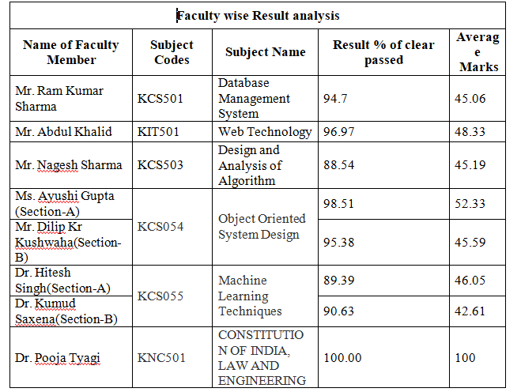
Department & Subject wise Result Analysis

Slide 19
Faculty wise Result Analysis
Semester & Section | Subject Code | Result
IT -V A | KCS-501
IT-V B | KCS-501

Slide 20
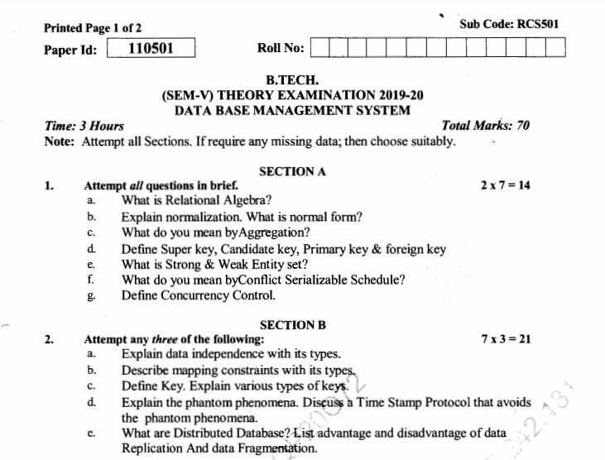
End Semester Question Paper

Slide 21
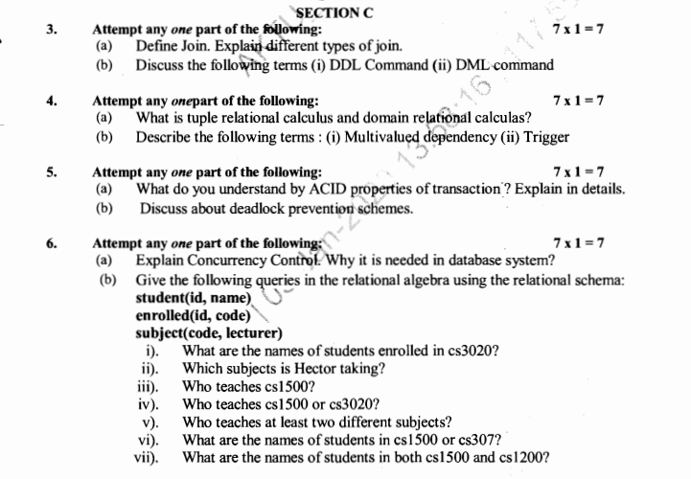

Slide 22
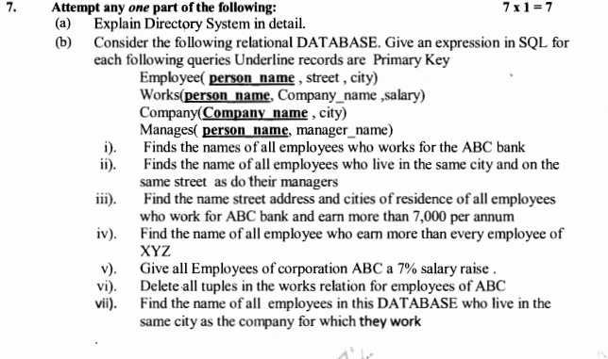

Slide 23
Prerequisite and Recap
The student should have basic knowledge of discrete mathematics.
The proper understanding of data structures and algorithms will help you to understand the DBMS quickly.
The Student should also be capable of implementing a large, complex system on UNIX in C or C++.

Slide 24
Brief Introduction of DBMS (CO1)
A very large, integrated collection of data.
Models real-world enterprise.
Entities (e.g., students, courses)
Relationships (e.g., Madonna is taking CS564)
A Database Management System (DBMS) is a software package designed to store and manage databases.

Slide 25
Content
Introduction
Syllabus
Course Objective
Course Outcomes
Program Outcome
Program Specific Outcomes
CO-PO Mapping
Unit-1 (Lecture 1)
Introduction to DBMS
Earlier Existing System
Database System Vs File Processing System
Disadvantage of DBMS
Faculty Video Links, Youtube & NPTEL Video Links and Online Courses Details
Daily Quiz
Weekly Assignment 1.1

Slide 26
Course Objective of DBMS
Students should be familiar with basic concepts of Database management system
They will be able to create database by using DBMS software
Student will come to know how to Maintains the database
Students will learn writing SQL queries which are useful in various applications
Any Software development needs the data base for storing and managing data efficiently by using a database management system so students will able to create backend
Practical implementation of ORACLE
Students will know how Transaction management take places

Slide 27
Content Unit 1(Lecture 1)
Unit-1 (Lecture 1)
Introduction to DBMS
Earlier Existing System
Database System Vs File Processing System
Disadvantage of DBMS
Faculty Video Links, Youtube & NPTEL Video Links and Online Courses Details
Daily Quiz
Weekly Assignment 1.1

Slide 28
Course Objective of Unit 1
Students will be familiar with basic concepts of Database management system and its architecture
Students should be familiar Use of different data models for implementation of data base and use of data base languages
Students should be able to draw ER diagram for designing the data base graphically

Slide 29
Topic mapping with CO
Introduction to DBMS (CO1)
Earlier Existing System (CO1)
Database System Vs File Processing System (CO1)
Disadvantage of DBMS (CO1)

Slide 30
Topic Objectives
Topic | Objective
 | Students will be able to
Introduction to DBMS | understand the basic concepts of DBMS
Earlier Existing System | Compare the existing systems with modern data base system
Database System Vs File Processing System | Analyse the advantages of DBMS over File Processing System
Disadvantage of DBMS | Know the drawback of DBMS and in subsequent unit he will be able to resolve these drawbacks

Slide 31
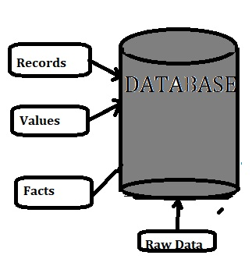
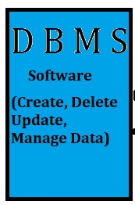
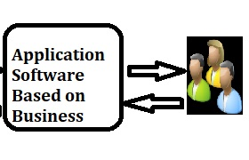

Introduction
Data Base Management System

Slide 32
Introduction to DBMS (CO 1)
Good data management is an essential prerequisite to corporate success.
Data Information
Information Knowledge
Knowledge Judgment
Judgment Decision
Decision Success
provided that data is:
complete
accurate
timely
easily available

Slide 33
Introduction to DBMS (CO 1) Contd..
What is Data ?
Data : is the raw facts and figures. It is represented with the help of characters like alphabets(A-Z), digits(0-9) and special characters (+,-,/,*,<,>,= etc.)
Example : 36 , Ravi,
What is Information ?
Information . Processed data is called information.
it is a set of organized or classified data so that it has some meaningful values.
Example : Age 36 is information, Name of Person is Ravi

Slide 34
Introduction to DBMS (CO 1) Contd..
What is Data Base?
Database made up of two separate words, i.e. Data and base means database is a base of data.
Database is a collection of related data organized in a way that data can be easily accessed, managed and updated.
Database actually a place where related piece of information is stored and perform various operation can be performed on it.

Slide 35
Introduction to DBMS (CO 1) Contd..
What is Data Base Management System (DBMS)?
A database Management System is a collection of programs that enables users to create and maintain a database.
DBMS is a general purpose software system that facilitate the process of defining , constructing , manipulation and sharing database among various users and application.

Slide 36
Introduction to DBMS (CO 1) Contd..
Contd..
Defining a database involves specifying the data types, structures and constraints for the data to be stored in the database.
Constructing the database is the process of storing the data itself on some storage medium.
Manipulating a database includes querying the database to retrieve the information, updating the database and generating the report form
Sharing a database allows multiple users and programs to access the database concurrently

Slide 37







DBMS (CO 1)
EXAMPLES
IBM DB2
Microsoft SQL Server
SAP Sybase ASE
Teradata
ADABAS
MySQL
FileMaker
Microsoft Access
Informix
SQLite
PostgreSQL
Amazon RDS
MongoDB
Redis
CouchDB

Slide 38
Database Applications (CO 1)
Banking: all transactions
Airlines: reservations, schedules
Universities: registration, grades
Sales: customers, products, purchases
Manufacturing: production, inventory, orders, supply chain
Human resources: employee records, salaries, tax deductions

Slide 39
Earlier Existing System (CO 1)
File Processing System
A file processing system is a collection of files and programs that access/modify these files.
Typically, new files and programs are added over time (by different programmers) as new information needs to be stored and new ways to access information are needed.

Slide 40
Database System Vs. File System (CO 1)
Data Redundancy problem
Data consistency problem
Data Isolation problem
Integrity Problem
Sharing of Data
Atomicity Problem
Concurrent Access Problem
Backup and Recovery Procedures Problem
Data Independence
Data Security problem

Slide 41
DBMS Advantages over File System (CO 1)
Controlling Data Redundancy
Data Consistency
Data Isolation Problem
Integration of Data
Sharing of Data
Atomicity Problem
Control Over Concurrency
Backup and Recovery Procedures
Data Independence

Slide 42
Database System Vs. File System (CO 1)
S.NO. | Database System | File System
1 | Data redundancy problem is not found | Here Redundancy Problem Exist
2 | Data Consistency exists | Data Consistency does not exists
3 | Accessing Database is easier | Accessing database is difficult
4 | The problem of data isolation not found on it | Data are scattered in various file in different format writing new program for accessing them
5 | Concurrent access and crash Recovery | Here There is no concurrent access and recovery
6 | Atomicity and integration problem are not found | Atomicity and integration problem are found
7 | Security of database good in DBMS | Here is not good

Slide 43
Disadvantages of DBMS (CO 1)
There are various disadvantages of DBMS are:-
Cost of Hardware and Software
Complexity of Backup and recovery
Cost of Staff training
Cost of Data conversion

Slide 44
Faculty Video Links, Youtube & NPTEL Video Links and Online Courses Details
https://nptel.ac.in/courses/106/104/106104135/
https://nptel.ac.in/courses/106106220/
https://www.youtube.com/watch?v=1057YmExS-I

Slide 45
Daily Quiz
Importance of DBMS
Application of DBMS
Outcomes of Course

Slide 46
Weekly Assignment 1.1
What are the advantages of DBMS over file system? CO1
What is primary goal of DBMS? CO1
What are the advantage and drawback of DBMS? CO1
Explain the term metadata. CO1,CO2
What do you mean by big data? What are the software to handle big data? CO1

Slide 47
Content Unit 1 (Lecture 2)
Unit 1 (Continued…)
Components of DBMS
Characteristics of DBMS
Actors of DBMS

Slide 48
Topic mapping with CO
Topic | CO
Components of DBMS | CO1
Characteristics of DBMS | CO1
Actors of DBMS | CO1

Slide 49
Topic Objectives
Topic | Objective
 | Students will be able to
Components of DBMS | understand the components of DBMS
Characteristics of DBMS | Know the properties of DBMS
Actors of DBMS | Understand that how a data base is handled by different persons like data base designer , developer and different type of users

Slide 50
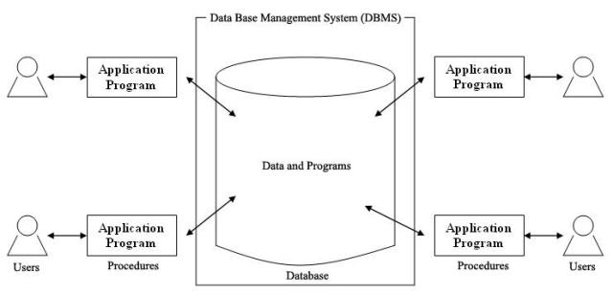
Components of DBMS (CO 1)
Database and DBMS software together is Database system
A database System involves four major components
Data
Hardware
Software
Users

Slide 51
Characteristics of DBMS (CO 1)
Self describing nature of a database.
Insulation between programs and data, and data abstraction.
Support of multiple views of the data
Sharing of data and multiuser transaction processing

Slide 52
Characteristics of DBMS (CO 1) Contd..
Self Describing Nature of a Database
The database system contains not only the database itself but also a complete definition or description of the database structure and constraints
This definition stored in DBMS catalog, which contains information of structure, type and storage format of each data items and various constraints
The information stored in the catalog is called Metadata.
Data about data is called Metadata

Slide 53
Characteristics of DBMS (CO 1) Contd..
Insulation between programs and data, and data abstraction
The structure of the data files is stored in DBMS catalog separately from the access program, known as Program-Data Independence.
Similarly , Database system supports Program-Operation Independence
The characteristics that allows Program-Data Independence and Program-Operation Independence is called Data Abstraction

Slide 54
Characteristics of DBMS (CO 1) Contd..
Data Abstraction
A database system is a collection of interrelated files(data) and a set of programs that allow users to access and modifies these (files)data. A major purpose of a database system is to provides users with an abstract view of the data. That is, the system hides certain details of how the data are stored and maintained.
Three level of abstraction
Physical level
Logical level
View Level

Slide 55
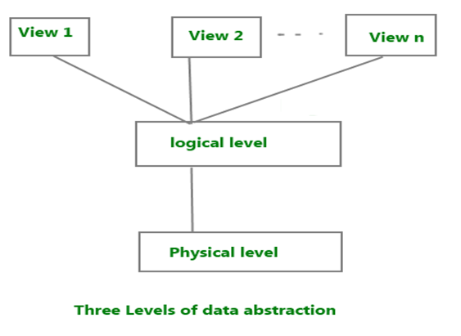
Abstraction in DBMS (CO 1)
External Level
Provides view of the database
What data are to be stored and relationship among data
Conceptual Level
Internal Level
How data are stored

Slide 56
Characteristics of DBMS (CO 1) Contd..
Support of multiple views of the data
A database system has many users , each of whom require a different perspective of the database.
A view maybe a subset of database or it may contain virtual data that is derived from the data base file.
Sharing of data and multiuser transaction processing
Allows multiple users to access the database at the same time.

Slide 57
Actors of DBMS (CO 1)
Database Administrator
Database Designers
End Users
Casual End Users
Naïve or parametric End Users
Sophisticated End Users
Stand Alone Users
System Analyst and Application Programmers

Slide 58
Content Unit 1 Lecture 3 and lecture 4
Data Model
Categories of Data Model
Schema
Instance
Architecture of DBMS
2Tier Architecture
3Tier Architecture (Three Level Architecture)

Slide 59
Topic mapping with CO
Topic | CO
Data Model | CO1
Categories of Data Model | CO1
Schema | CO1
Instance | CO1
Architecture of DBMS 2Tier Architecture 3Tier Architecture (Three Level Architecture) | CO1

Slide 60
Topic Objectives
Topic | Objective
 | Students will be able to
Data Model | understand the DBMS designing models
Categories of Data Model | Categorize data model and can compare them
Schema | Design overall data structure, data types for data base
Instance | Know that data base values at particular time
Architecture of DBMS 2Tier Architecture 3Tier Architecture (Three Level Architecture) | Know the architecture of Data base, its componets

Slide 61
Data Model (CO 1)
A collection of concepts that can be used to describe the structure of database
It provides the necessary means to achievements of data abstraction
Most data model also include set of basic operations of retrieval and updates

Slide 62
Categories of Data Model (CO 1)
Categorization according to the concepts they used to describe the database structure
High level or conceptual Data Model
Provide concepts that describe the way many user perceive the data
Low level or Physical Data Model
Provide concepts that describe the details of how data is stored in computer.
Representational Data Model
Provide concepts that may be understood by end user but that are not too far removed from the way data is organized within the system

Slide 63
Categories of Data Model (CO 1) contd..
Categorization according to the Representational or implementation
Hierarchical Model
Network Database Model
Relational Model
Object Oriented Model

Slide 64
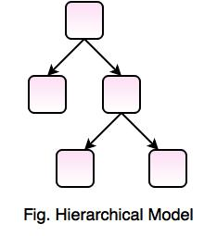
Categories of Data Model (CO 1) contd..
Hierarchical Model
In this model, the data is sorted hierarchically.
It represents the data in a hierarchical tree structure.
It uses pointer to navigate between the stored data.

Slide 65
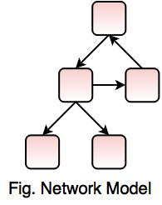
Categories of Data Model (CO 1) contd..
2. Network Database Model
Network Database Model is same like Hierarchical Model, but the only difference is that it allows a record to have more than one parent.
In this model, there is no need of parent to child association like the hierarchical model.
It replaces the hierarchical tree with a graph.
It represents the data as record types and one-to-many relationship.
This model is easy to design and understand.

Slide 66
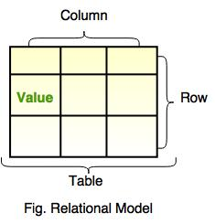
Categories of Data Model (CO 1) contd..
3. Relational Model
This model was first proposed by E. F. Codd.
It represents data as relations or tables.
Relational database simplifies the database structure by making use of tables and columns.

Slide 67
Categories of Data Model (CO 1) contd..
4. Object Oriented Model
Object model stores the data in the form of objects, classes and feature of object oriented model like inheritance.
This model handles more complex applications, such as Geographic Information System (GIS), scientific experiments, engineering design and manufacturing.
It is used in File Management System.
It represents real world objects, attributes and behaviors.
It provides a clear modular structure.
It is easy to maintain and modify the existing code.

Slide 68
Schema (CO 1)
A database schema is the skeleton structure that represents the logical view of the entire database.
It is not expected to change frequently.
When we define a new database we specify its database schema.
It defines how the data is organized and how the relations among them are associated.
It formulates all the constraints that are to be applied on the data.
Example:
Studen ID | SName | Age | Branch | Address

Slide 69
Instance (CO 1)
Database change overtime as information is inserted and deleted. The collection of information stored in the database at a particular moments is called an instances of the database.
It is also called database state or snapshot.
( actual content of the database at a particular point in time)
Studen ID | SName | Age | Branch | Address
: | : | : | : | :
123 | Aman | 25 | CSE | KP 2 Gr Noida
: | : | : | : | :
: | : | : | : | :

Slide 70
More Concepts on Database Schema (CO 1)
A database schema describes the structure and organization of data in a database system, while a table is a data set in which the data is organized in to a set of vertical columns and horizontal rows.
The database schema defines the tables in a database, the columns and their types.
In addition the schema also defines what columns are defined as the primary key of a table.
Understandably, the schema of a database keeps constant once created, while the actual data in the database tables may change all the time.

Slide 71
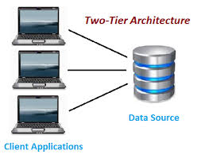
Architecture of DBMS (CO 1)
There are two types of application Architecture of DBMS
Two Tier Architecture
Three Tier Architecture
Two Tier Architecture
It is Client –Server Based Architecture
Direct Communication
Heavy load on Server
Potential Congestion on Network
Presentation and Logic Layer Still tightly coupled

Slide 72
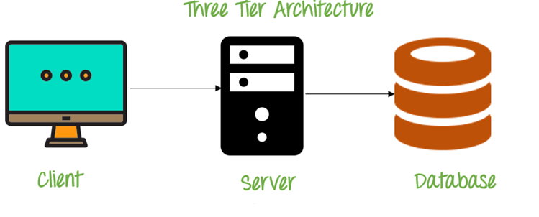
Three Tier Architecture (CO 1)
It is the most widely used architecture to design a DBMS.
The objective of the three level architecture is to separate each user's view of the database from the Way the database is physically represented.

Slide 73
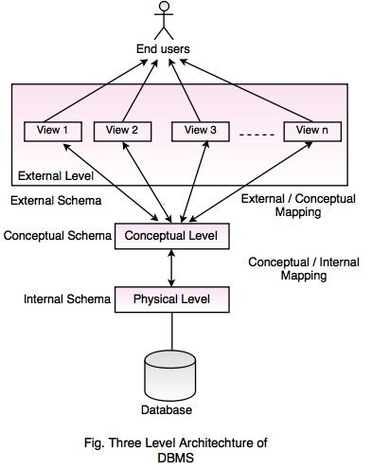
Architecture of DBMS- Three Level Architecture
Contd…

Slide 74
Architecture of DBMS- Three Level Architecture
Contd…
1. Physical Level
Physical level describes the physical storage structure of data in database.
It is also known as Internal Level.
This level is very close to physical storage of data.
At lowest level, it is stored in the form of bits with the physical addresses on the secondary storage device.
At highest level, it can be viewed in the form of files.
The internal schema defines the various stored data types. It uses a physical data model.

Slide 75
Daily Quiz
https://docs.google.com/forms/d/e/1FAIpQLSeS6o22-VOd4TNHrGIyZpsrX5OJ1RbLhmSb9-w2eLcXeXFOiA/viewform?usp=sf_link

Slide 76
Architecture of DBMS- Three Level Architecture
Contd…
2. Conceptual Level
Conceptual level describes the structure of the whole database for a group of users.
It is also called as the data model.
Conceptual schema is a representation of the entire content of the database.
These schema contains all the information to build relevant external records.
It hides the internal details of physical storage.

Slide 77
Architecture of DBMS- Three Level Architecture
Contd…
3. External Level
External level is related to the data which is viewed by individual end users.
This level includes a no. of user views or external schemas.
This level is closest to the user.
External view describes the segment of the database that is required for a particular user group and hides the rest of the database from that user group.

Slide 78
Daily Quiz
https://docs.google.com/forms/d/e/1FAIpQLSe9KzGTbkYpGaE0bevUtvtG7Rt5u2T4j4hEJI7V3jWcQx_nMw/viewform?usp=sf_link

Slide 79
Content Unit 1 Lecture 5
DBMS LANGUAGE
DDL
DML
DCL
TCL
Overall System Structure
Faculty Video Links, Youtube & NPTEL Video Links and Online Courses Details
Weekly Assignment 1.2

Slide 80
Prerequisite Unit 1 Lecture 5
Mathematical functions
Operating system
Data structures

Slide 81
Topic mapping with CO
Topic | CO
DBMS LANGUAGE DDL DML DCL TCL | CO1, CO2
Overall System Structure | CO1

Slide 82
Topic Objectives
Topic | Objective
DBMS LANGUAGE DDL DML DCL TCL | CO1, CO2
Overall System Structure | CO1

Slide 83
DBMS LANGUAGE (CO 1)
DBMS LANGUAGE
DATA DEFINITION LANGUAGE
(DDL)
DATA MANIPULATION LANGUAGE
(DML)
DATA CONTROL LANGUAGE
(DCL)
TRANSACTION CONTROL LANGUAGE
(TCL)

Slide 84
Data Definition Language (DDL) (CO 1)
DDL is used for specifying the database schema. It is used for creating tables, schema, indexes, constraints etc. in database.
Operations that we can perform on database using DDL:
To create the database instance – CREATE
To alter the structure of database – ALTER
To drop database instances – DROP
To delete tables in a database instance – TRUNCATE
To rename database instances – RENAME
To drop objects from database such as tables – DROP
To Comment – Comment

Slide 85
Data Manipulation Language (DML) (CO 1)
DML is used for accessing and manipulating data in a database.
The following operations on database comes under DML:
To read records from table(s) – SELECT
To insert record(s) into the table(s) – INSERT
Update the data in table(s) – UPDATE
Delete all the records from the table – DELETE

Slide 86
Data Control Language (DCL) (CO 1)
DCL is used for granting and revoking user access on a database –
To grant access to user – GRANT
To revoke access from user – REVOKE

Slide 87
Transaction Control Language (TCL) (CO 1)
The changes in the database that we made using DML commands are either performed or rollbacked using TCL.
To persist the changes made by DML commands in database – COMMIT
To rollback the changes made to the database – ROLLBACK

Slide 88
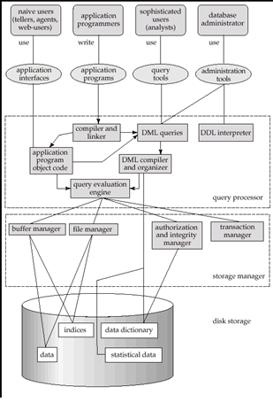
Overall System Structure (CO 1)

Slide 89
Overall System Structure (CO 1) contd..
Storage Management
Storage manager is a program module that provides the interface between the low-level data stored in the database and the application programs and queries submitted to the system.
The storage manager is responsible to the following tasks:
interaction with the file manager
efficient storing, retrieving and updating of data

Slide 90
Overall System Structure (CO 1) contd..
The Buffer manager is responsible for fetching the data from disk storage into main memory and deciding what data to cache in main memory.
The file manager manages the allocation of space on disk storage
Transaction manager ensures that the database remains in a consistent state and allowing concurrent transactions to proceed without conflicting.
Authorization and Integrity Manger tests for the satisfaction of integrity constraints and checks the authority of users to access data.

Slide 91
Overall System Structure (CO 1) contd..
The DDL interpreter interprets DDL statements and records the definition in the data dictionary
DML COMPILER translates DML statements in a query language into low-level instruction that the query evaluation engine can understand.
Query evaluation engine: it executes low level instructions generated by compiler

Slide 92
Overall System Structure (CO 1) contd..
A data dictionary is a file or a set of files that contains a database's metadata. The data dictionary contains records about other objects in the database, such as data ownership, data relationships to other objects, and other data.
The data dictionary is a crucial component of any relational database. Typically, only database administrators interact with the data dictionary.
Indices: provide fast access to data items holding particular values.

Slide 93
Daily quiz
https://docs.google.com/forms/d/e/1FAIpQLSf8VFC0DpsPXCdLR5GnIHwZJ75VOUAwAWOvQgbsOrkcRaY6UQ/viewform?usp=sf_link

Slide 94
Daily Quiz
https://docs.google.com/forms/d/e/1FAIpQLSe9KzGTbkYpGaE0bevUtvtG7Rt5u2T4j4hEJI7V3jWcQx_nMw/viewform?usp=sf_link

Slide 95
Faculty Video Links, Youtube & NPTEL Video Links and Online Courses Details
You tube /other Video Link
https://nptel.ac.in/courses/106105175/
https://www.youtube.com/watch?v=CZfmqC9dMJA

Slide 96
Weekly Assignment 1.2
What are the different types of data base users? Discuss their activities. CO1
What are the five main functions of DBA? CO1
What are the different database languages? CO1
What are the components of query processor in DBMS architecture? CO1
List two reasons why do we have several levels of abstractions. Also explain the three levels. CO1
What do you mean by database schema and database instance? CO1,CO2
Explain the physical and logical level data independence. CO1
Differentiate between hierarchical and network data model. CO1

Slide 97
Content Unit 1 (Lecture 6 and lecture 7)
Entity Relationship Model
ER Model Basic
Entity
Entity Type
Attribute
Attribute Type
Key and Key Attributes
Relationship
Relationship Type
Notation
ER Diagram Example
Mapping Cardinality
Old Question Paper
References

Slide 98
Prerequisite Unit 1 Lect. 6 and Lect. 7
Set theory

Slide 99
Topic mapping with CO
Topic | CO
Entity Relationship Model | CO1
ER Model Basic Entity Entity Type Attribute Attribute Type Key and Key Attributes Relationship Relationship Type Notation ER Diagram Example | CO1
Mapping Cardinality | CO1

Slide 100
Topic Objectives
Topic | Objectives
Entity Relationship Model | Students will understand basic ER model to design a data base
ER Model Basic Entity Entity Type Attribute Attribute Type Key and Key Attributes Relationship Relationship Type Notation ER Diagram Example | Students will be able to different terminologies and their symbolic representations to draw a ER model
Mapping Cardinality | It will represent the relationships among different entities used in ER diagram

Slide 101
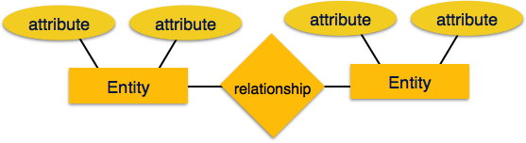
Entity Relationship Model (CO2)
E-R model of real world
Entities (objects)
E.g. customers, accounts, bank branch
Relationships between entities
E.g. Account A-101 is held by customer Johnson
Relationship set depositor associates customers with accounts

Slide 102
ER Model Basics (CO2)
Entity:
Real-world object distinguishable from other objects.
E.g. customers, accounts, bank branch
An entity can usually be classified by Entity Type
Ex.
All customers are the instance of Customer entity type.
Entity Set:
A collection of similar entities. E.g., all employees.

Slide 103
ER Model Basics (CO 2) contd..
Attributes
Attribute describe the property of entity and relationship.
An instance of an attribute is called value, which is drawn from domain.
Attribute types:
Simple and composite attributes.
E.g. Composite Attribute : Address of FlatNo, Street, City, Sate.
Single-valued and multi-valued attributes
E.g. multivalued attribute: phone-numbers
Derived attributes
Can be computed from other attributes
E.g. age, given date of birth

Slide 104
ER Model Basics (CO 2) contd..
Key and key attributes:
Key: a unique value for an entity
Key attributes: a group of one or more attributes that uniquely identify an entity in the entity set
Super key, candidate key, and primary key
Super key: a set of attributes that allows to identify an entity uniquely in the entity set
Candidate key: minimal super key
There can be many candidate keys
Primary key: a candidate key chosen by the designer

Slide 105
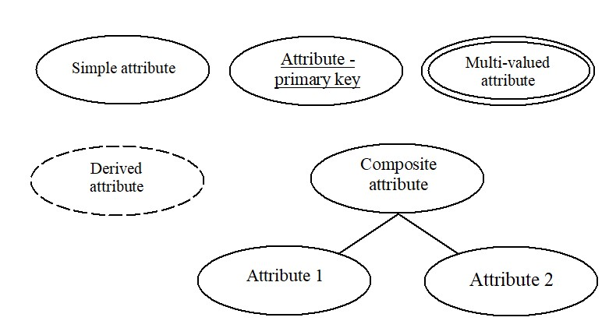
ER Model Basics (CO 2) contd..
Attribute Types

Slide 106
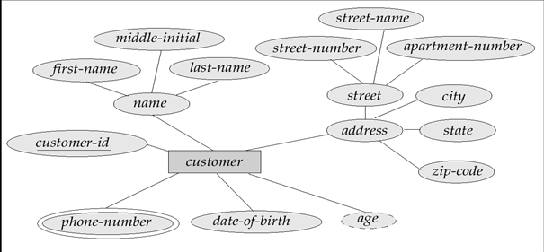
ER Model Basics (CO 2) contd..
Entity With Composite, Multi valued, and Derived Attributes

Slide 107
ER Model Basics (CO 2) contd..
Entity With Composite, Multi valued, and Derived Attributes

Slide 108
ER Model Basics (CO 2) contd..
Relationship
Association among two or more entities.
i.e. Any entity can be related to other entities via relationships.
Ex. A supplier may supply some part.
Relationship Type
Relationship can usefully be classified into Relationship Type
e.g. “AS1 Supplier Supply P1” and “S1 supply P2” are instances of SUPPLY relationship Type
Relationship Set: Collection of similar relationships.

Slide 109
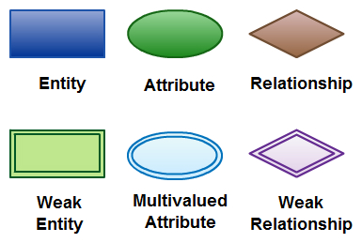
ER Model Basics (CO 2) contd..
Notations

Slide 110
ER Model Basics (CO 2) contd..

Slide 111
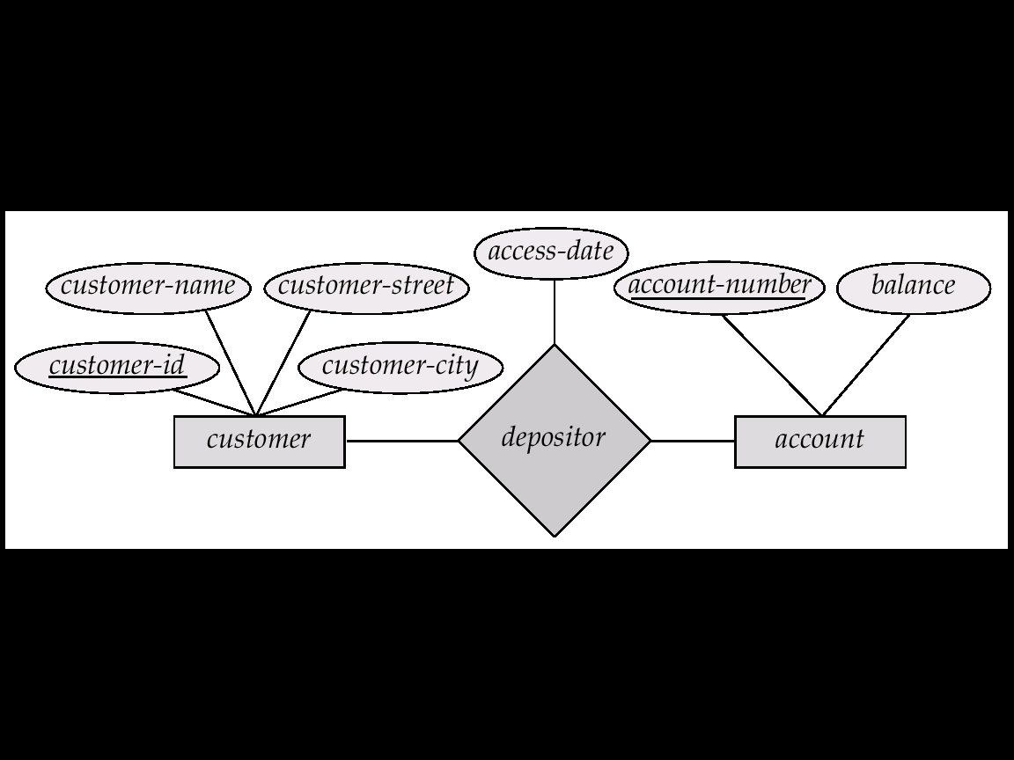
E R Diagram – Example (CO 2)
Bank Information System

Slide 112
Mapping Cardinality (CO 2)
Express the number of entities to which another entity can be associated via a relationship set.
Binary
Ternary
N-ary
For a binary relationship set the mapping cardinality must be one of the following types:
One to one
One to many
Many to one
Many to many

Slide 113
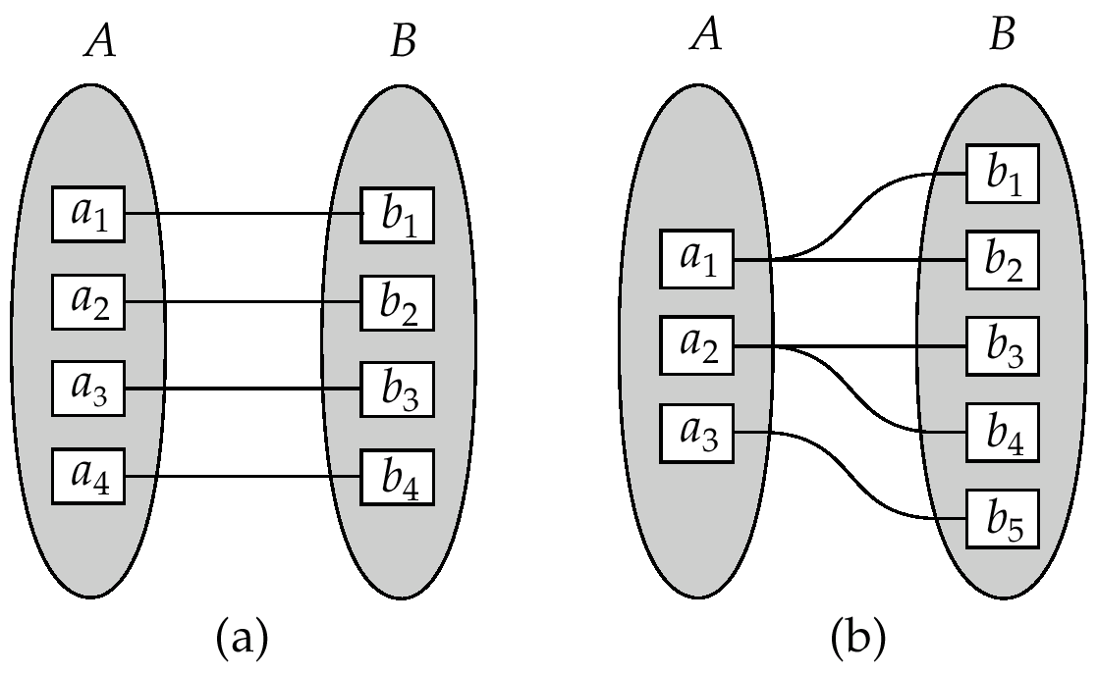
Mapping Cardinality (CO 2) contd..
One to one
One to many
Note: Some elements in A and B may not be mapped to any
elements in the other set

Slide 114
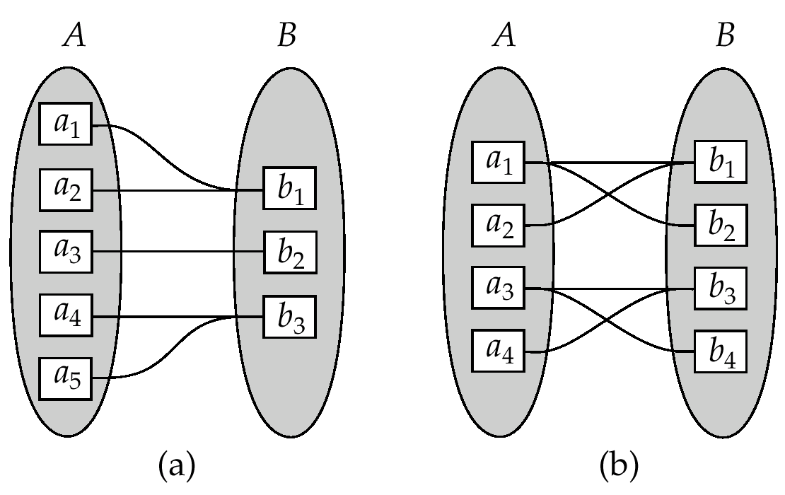
Mapping Cardinality (CO 2)
Many to one
Many to many
Note: Some elements in A and B may not be mapped to any
elements in the other set

Slide 115
Participation of an Entity Set in a Relationship Set (CO 2) contd..
Total participation every entity in the entity set participates in at least one relationship in the relationship set
E.g. participation of loan in borrower is total
every loan must have a customer associated to it via borrower
Partial participation: some entities may not participate in any relationship in the relationship set
E.g. participation of customer in borrower is partial

Slide 116
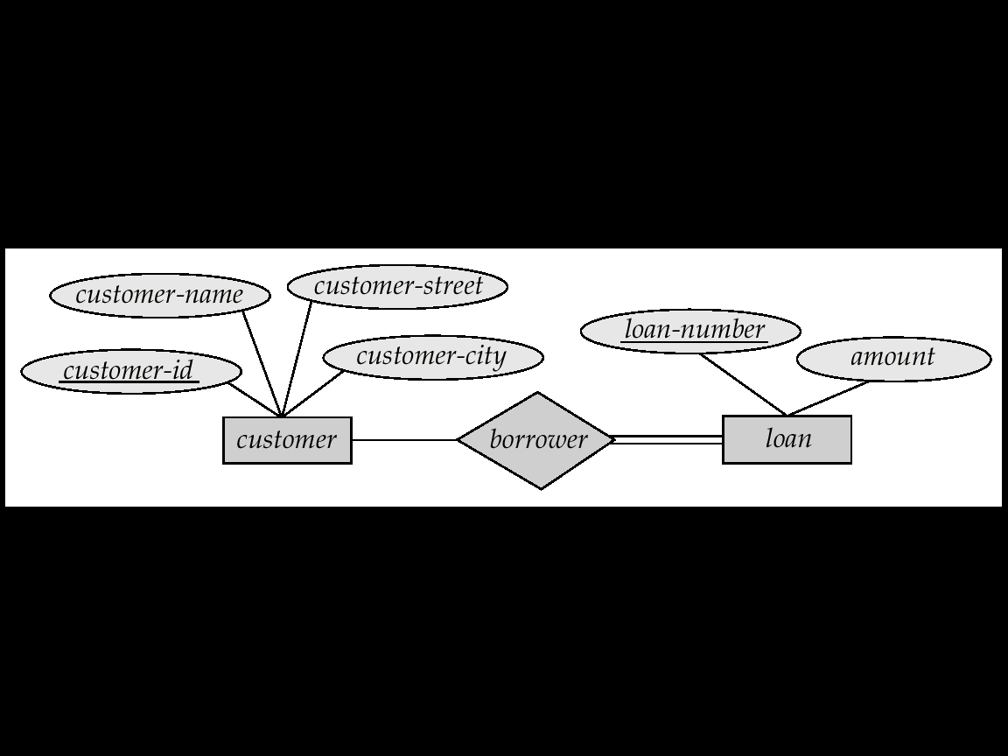
Participation of an Entity Set in a Relationship Set (CO 2) contd..
Total participation
Partial participation:
indicated by double line

Slide 117
Weak Entity Sets (CO 2)
An entity set that does not have a primary key is referred to as a weak entity set.
A weak entity must participate in an identifying relationship type with an owner or identifying entity type
Weak entity set must have total participation in this identifying relationship set.

Slide 118
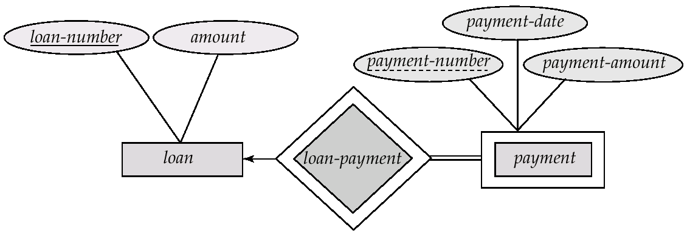
Weak Entity Sets (CO 2)
Example:
A PAYMENT entity is identified by the payment-number, and the specific LOAN with whom the payment is related
payment-number of PAYMENT is the partial key
PAYMENT is a weak entity type
LOAN is its identifying entity type via the identifying relationship type Loan_Payment

Slide 119
Specialization (CO 2)
An entity is divided into sub-entities based on their characteristics.
It is a top-down approach where higher level entity is specialized into two or more lower level entities.
Attribute inheritance – a lower-level entity set inherits all the attributes and relationship participation of the higher-level entity set to which it is linked.
Depicted by a triangle component labeled ISA (E.g. customer “is a” person).

Slide 120
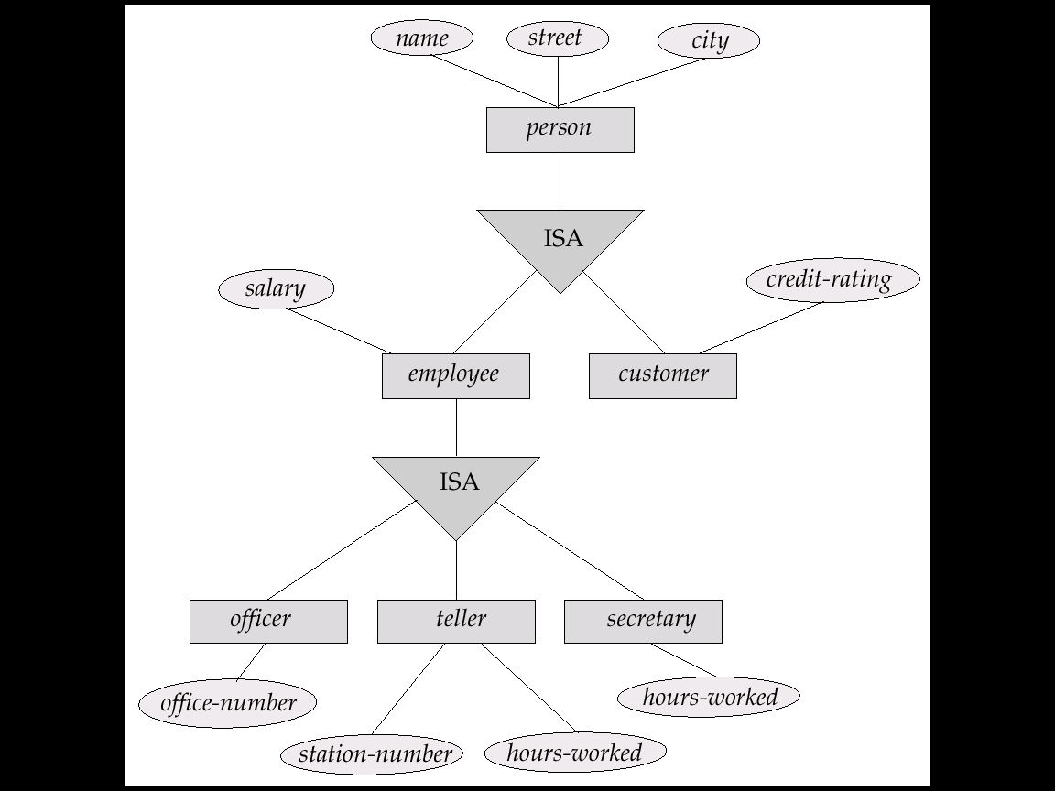
Specialization Example (CO 2)

Slide 121
Generalization (CO 2)
Generalization is the process of extracting common properties from a set of entities and create a generalized entity from it.
A bottom-up design process – combine a number of entity sets that share the same features into a higher-level entity set.
Specialization and generalization are simple inversions of each other; they are represented in an E-R diagram in the same way.
The terms specialization and generalization are used interchangeably

Slide 122
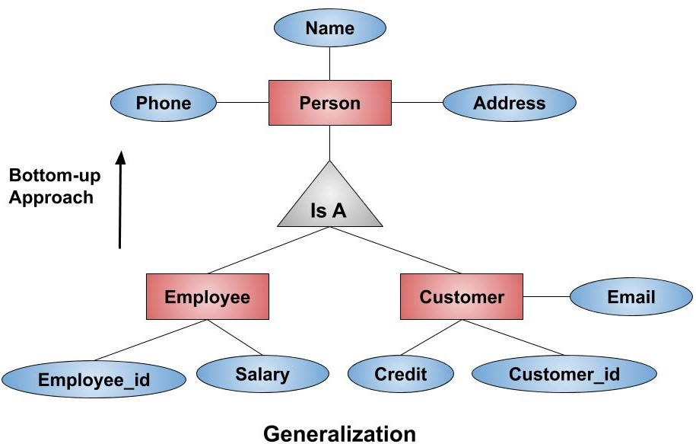
Generalization Example (CO 2)

Slide 123
Aggregation (CO 2)
Aggregation is a process when relation between two entities is treated as a single entity.
An ER diagram is not capable of representing relationship between an entity and a relationship which may be required in some scenarios.
In those cases, a relationship with its corresponding entities is aggregated into a higher level entity.

Slide 124
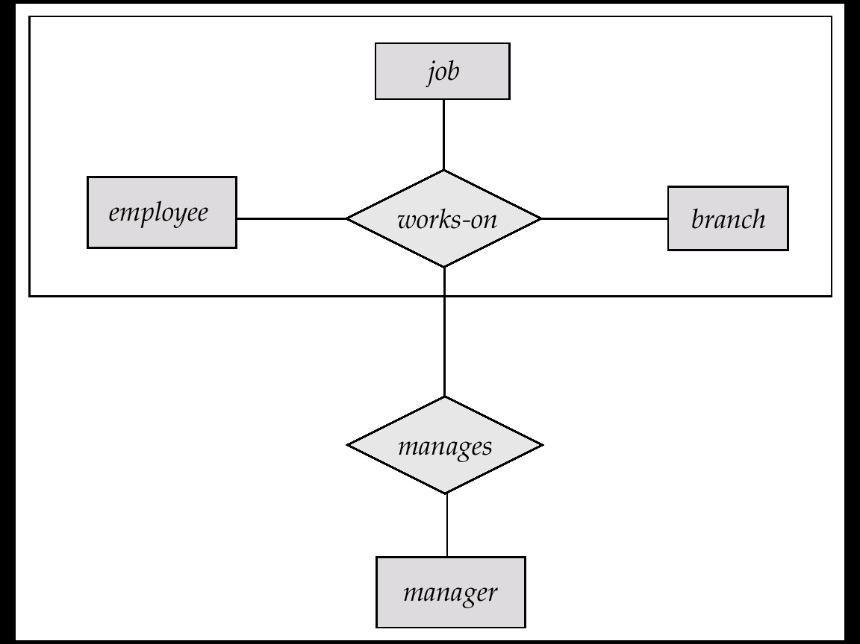
Aggregation Example (CO 2)
Suppose we want to record managers for tasks performed by an employee at a branch

Slide 125
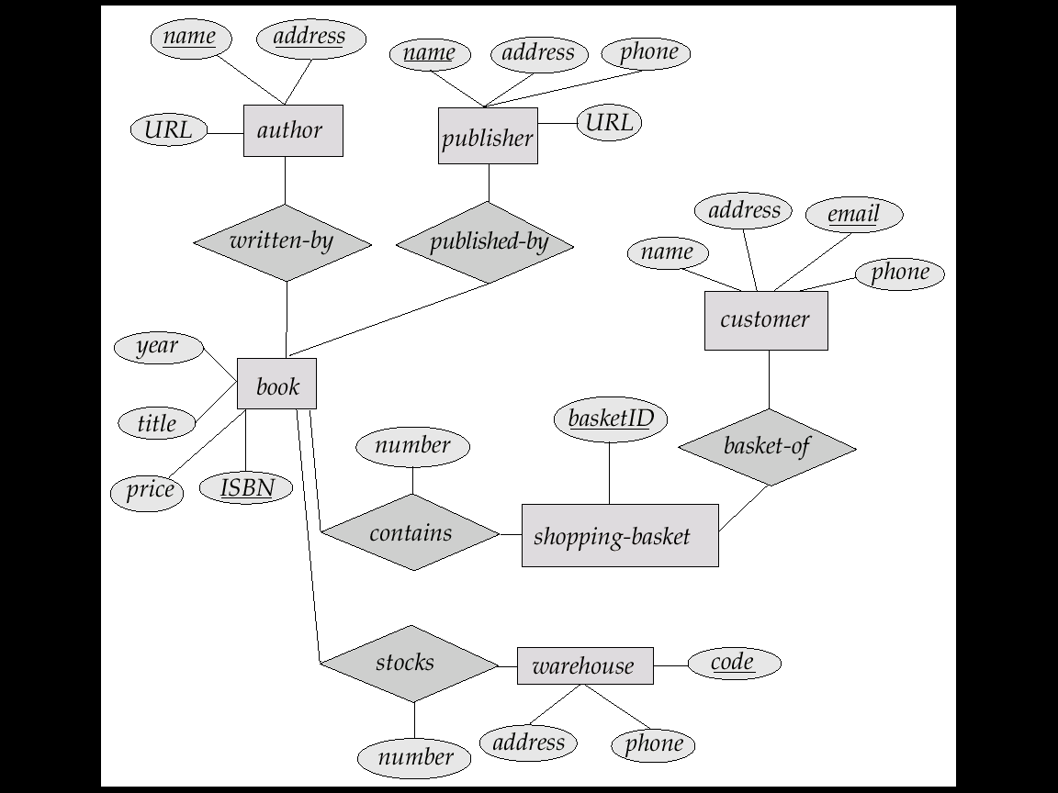
ER Diagram –On Line Book Shop (CO 2)

Slide 126
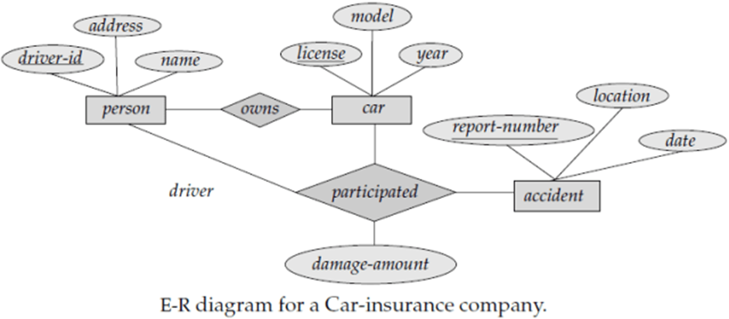
ER Diagram –Exercise (CO 2)
Construct an E-R diagram for a car-insurance company whose customers own one or more cars each. Each car has associated with it zero to any number of recorded accidents.

Slide 127
ER Diagram –Exercise (CO 2)
Construct an E-R diagram for a car-insurance company whose customers own one or more cars each. Each car has associated with it zero to any number of recorded accidents.

Slide 128
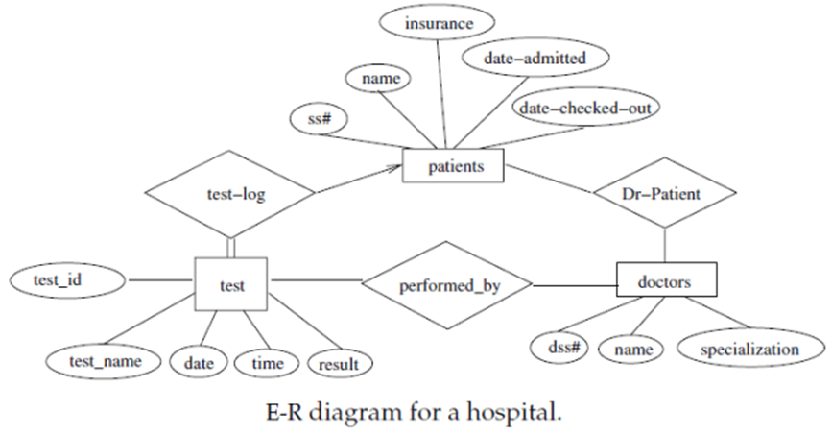
ER Diagram –Exercise (CO 2)
Construct an E-R diagram for a hospital with a set of patients and a set of medical doctors. Associate with each patient a log of the various tests and examinations conducted.

Slide 129
ER Diagram –Company Database (CO 2)
We need to create a database schema design based on the following (simplified) requirements of the COMPANY Database:
The company is organized into DEPARTMENTs. Each department has a name, number and an employee who manages the department. We keep track of the start date of the department manager. A department may have several locations.
Each department controls a number of PROJECTs. Each project has a unique name, unique number and is located at a single location.
We store each EMPLOYEE’s social security number, address, salary, sex, and birthdate.
Each employee works for one department but may work on several projects.
We keep track of the number of hours per week that an employee currently works on each project.
We also keep track of the direct supervisor of each employee
Each employee may have a number of DEPENDENTs.
For each dependent, we keep track of their name, sex, birthdate, and relationship to the employee.

Slide 130
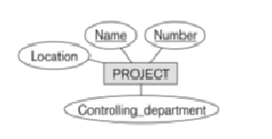
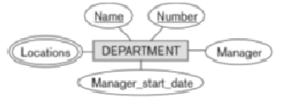
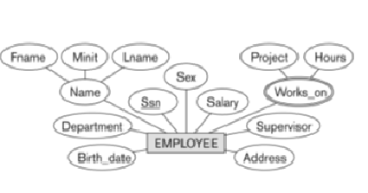
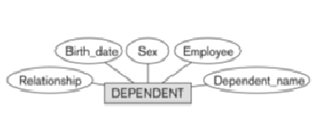
ER Diagram –Company Database (CO 2)
Initial Design of Entity Types for the COMPANY Database Schema
Identify initial entity types in the COMPANY database:
● DEPARTMENT  PROJECT  EMPLOYEE  DEPENDENT

Slide 131
ER Diagram –Company Database (CO 2)
Now examine the relationship between the entities
As per the requirement following are the relationship with their participating Entity types
WORKS_FOR (between EMPLOYEE, DEPARTMENT)
MANAGES (also between EMPLOYEE, DEPARTMENT)
CONTROLS (between DEPARTMENT, PROJECT)
WORKS_ON (between EMPLOYEE, PROJECT)
SUPERVISION (between EMPLOYEE (as subordinate),EMPLOYEE (as supervisor))
DEPENDENTS_OF (between EMPLOYEE, DEPENDENT)

Slide 132
ER Diagram –Company Database (CO 2)

Slide 133
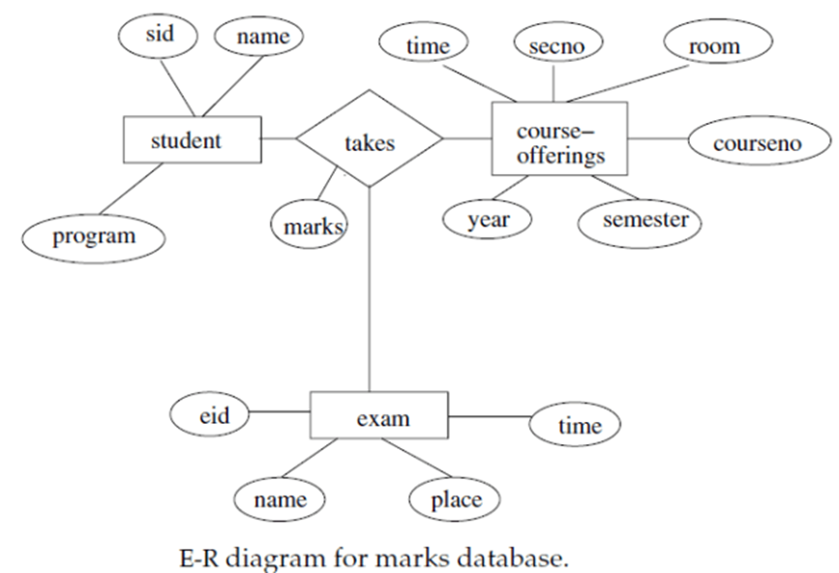
ER Diagram –Exercise (CO 2)
Consider a database used to record the marks that students get in different exams of different course offerings. Construct an E-R diagram that models exams as entities, and uses a ternary relationship, for the above database.

Slide 134
ER Diagram –Exercise (CO 2)
Suppose you are given the following requirements for a simple database for the National Hockey League (NHL):
The NHL has many teams,
each team has a name, a city, a coach, a captain, and a set of players,
each player belongs to only one team,
each player has a name, a position (such as left wing or goalie), a skill level, and a set of injury records,
a team captain is also a player,
a game is played between two teams (referred to as host_team and guest_team) and has a date (such as May 11th, 1999) and a score (such as 4 to 2).
Construct a clean and concise ER diagram for the NHL database.

Slide 135
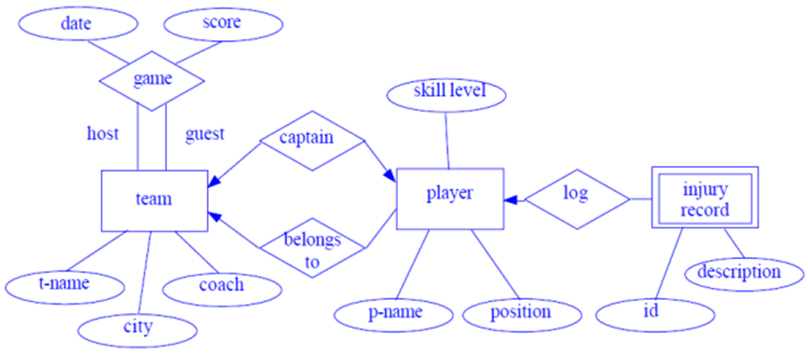
ER Diagram –Solution (CO 2)

Slide 136
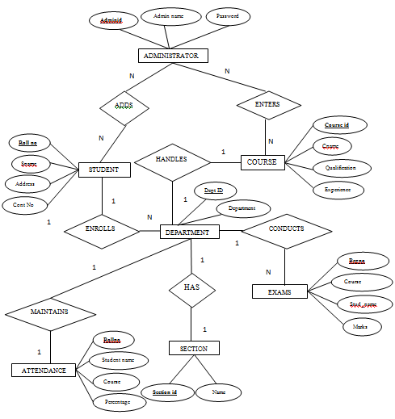
ER Diagram –Student Information System

Slide 137
Faculty Video Links, Youtube & NPTEL Video Links and Online Courses Details
Self Made Video Link:
Youtube/other Video Links
https://www.youtube.com/watch?v=Wv1c9K4788A

Slide 138
Daily Quiz
Define Database System.
What do you understand by data independence?
Explain types of attributes in ER diagram.
What is generalization.
What do you understand by primary key?
Explain participation cardainility.

Slide 139
Weekly Assignment
Define: Data, Database, and Database System.
What is data independence? What are differences between Logical Data Independence and Physical Data Independence?
Give example of Simple, Composite, Single –valued and Multi-valued attributes of an entity.
What is the difference between Generalization & Specialization with respect to Database?
What is difference between total and partial participation? Explain by suitable example.
Construct an E-R diagram for a hospital with a set of patients and a set of medical doctors. Associated with each patient, a log of the various tests and examinations conducted.

Slide 140
MCQ s
The entity relationship set is represented in E-R diagram as a) Double diamonds b) Undivided rectangles c) Dashed lines d) Diamond
The Rectangles divided into two parts represents a) Entity set b) Relationship set c) Attributes of a relationship set d) Primary key

Slide 141
MCQ s
An entity set that does not have sufficient attributes to form a primary key is termed a __________ a) Strong entity set b) Variant set c) Weak entity set d) Variable set
What term is used to refer to a specific record in your music database; for instance; information stored about a specific album? a) Relation b) Instance c) Table d) Column

Slide 142
Glossary Questions
Fill in the blanks using given keywords
(Metadata, Table, weak entity set, instance, Diamond)
The entity relationship set is represented in E-R diagram as___________.
An entity set that does not have sufficient attributes to form a primary key is termed a __________
___________ is used to refer to a specific record in your music database; for instance; information stored about a specific album.
Data is stored in the database management system in _________ form.
Information about data called __________.

Slide 143
Summary
Knowledge of database architecture.
Knowledge of Entity Relationship model and its concepts.
Databse V/S File system.

Slide 144
MCQ (CO 2)
https://forms.gle/ooM16K5jcFbDDvM46

Slide 145
Faculty Video Links, Youtube & NPTEL Video Links and Online Courses Details
You tube /other Video Link
https://nptel.ac.in/courses/106105175/ (Lecture 13,14,15
https://www.youtube.com/watch?v=Wv1c9K4788A&list=PLEbnTDJUr_Ic_9b4PcKmlae41cyxEefot&index=3

Slide 146
Old Question Papers
https://drive.google.com/drive/u/0/folders/1gWUEwo7Ztpxs4smy34fl9jWQrx4AKpkC

Slide 147
Old Question Papers
http://www.aktuonline.com/papers/btech-cs-5-sem-data-base-management-system-KCS501-2020.pdf
http://www.aktuonline.com/papers/btech-cs-5-sem-database-management-system-rcs-501-2018-19.pdf
http://www.aktuonline.com/papers/btech-cs-5-sem-database-management-system-ncs-502-2017-18.pdf
http://www.aktuonline.com/papers/btech-cs-5-sem-database-management-system-ncs-502-2016-17.pdf

Slide 148
References
Korth, Silbertz, Sudarshan,” Database Concepts”, McGraw Hill
Date C J, “An Introduction to Database Systems”, Addision Wesley
Elmasri, Navathe, “ Fundamentals of Database Systems”, Addision Wesley
Thank You

